Slide 1
Topic 7: UI Design Principles (part 3)
SECV2113 Human-Computer Interaction
Faculty of Computing
Universiti Teknologi Malaysia

Slide 2
HCI PRINCIPLES
01
VISUAL PERCEPTION
02
INDUSTRY PRACTICE
03

Slide 3
HCI
PRINCIPLES

Slide 4
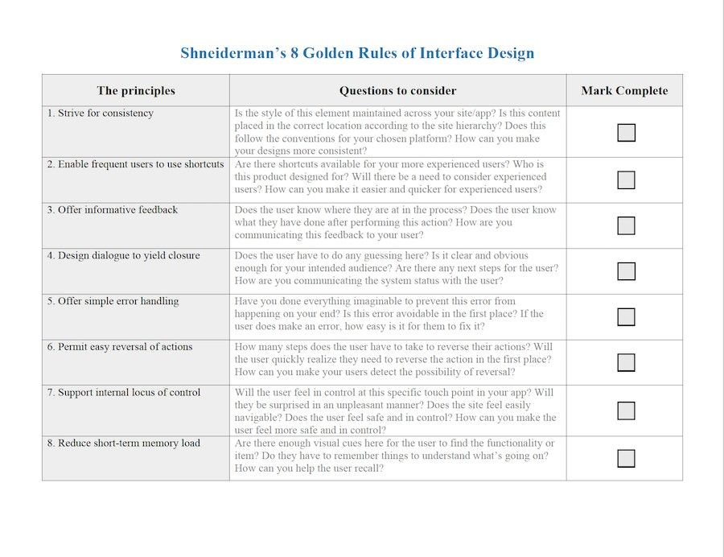

Slide 5
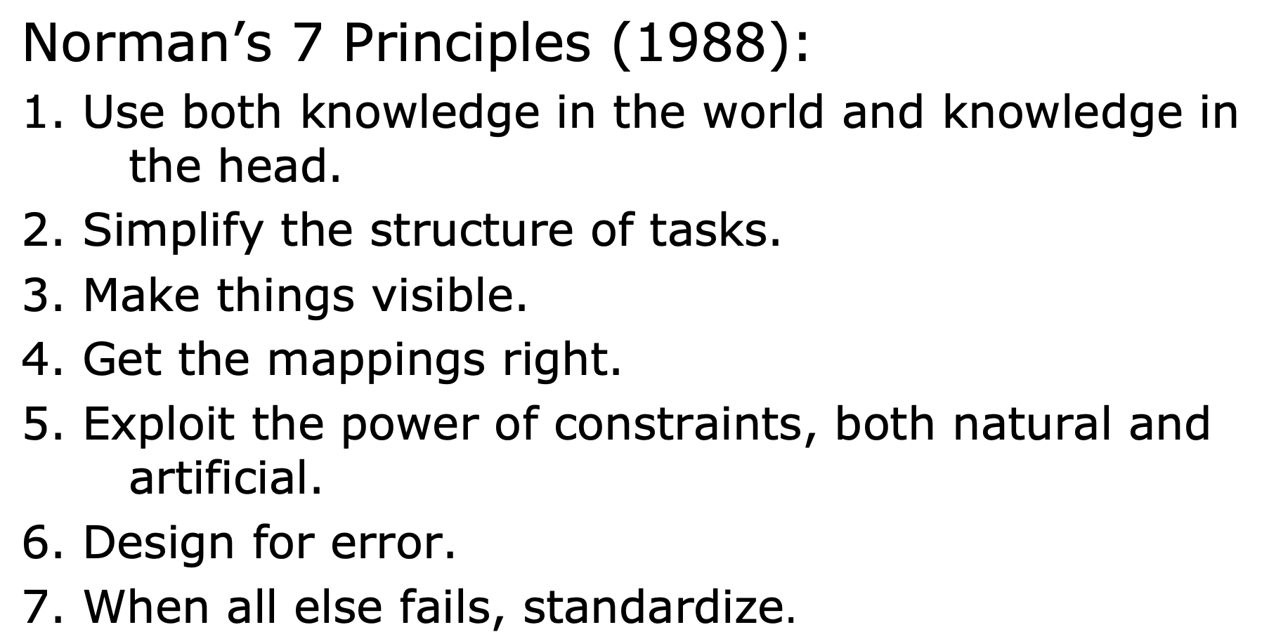

Slide 6
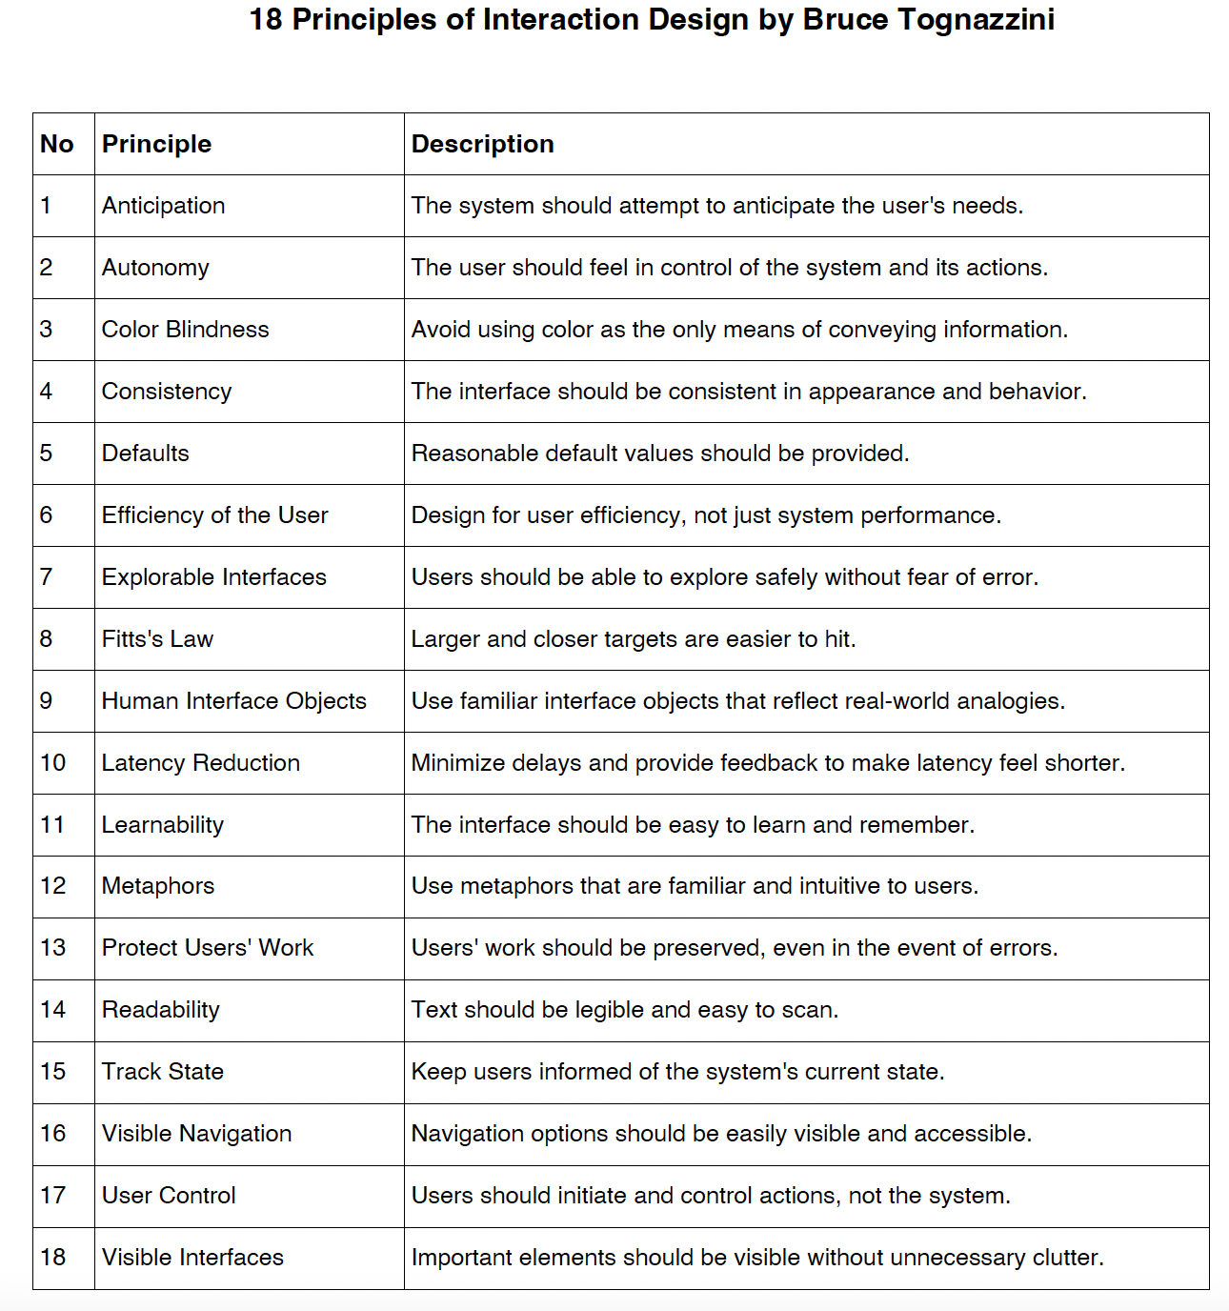

Slide 7
VISUAL PERCEPTION

Slide 8
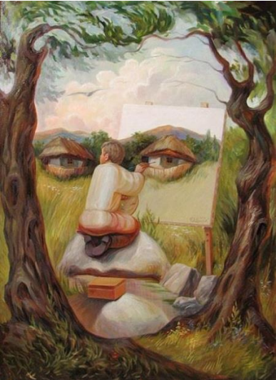
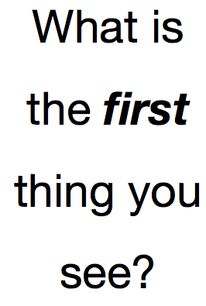

Slide 9
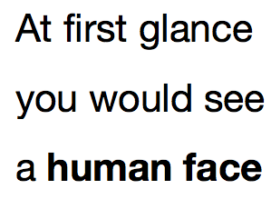

Slide 10
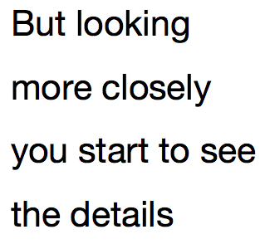

Slide 11
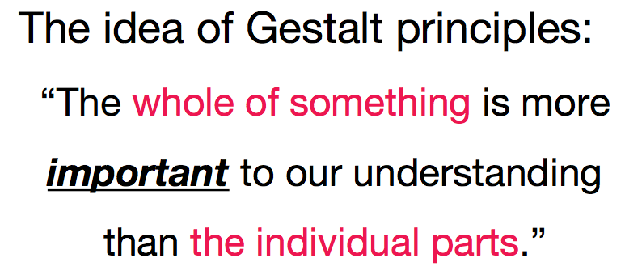

Slide 12
Gestalt Principles in UI Design
Similarity
Proximity
Enclosure
Continuation
Figure & Ground

Slide 13
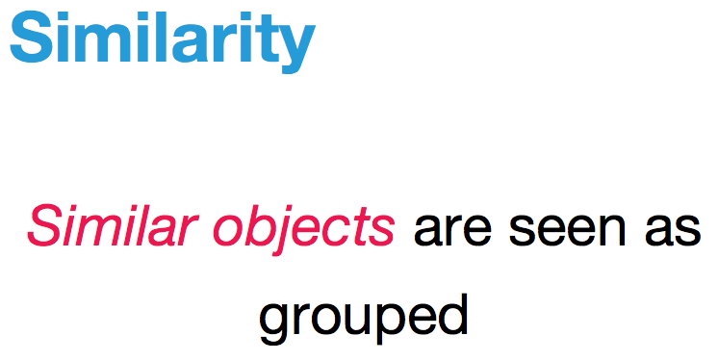

Slide 14
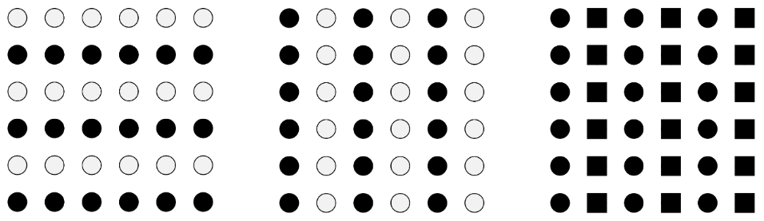
Similarity
Similarity of objects form groupings:
At left, light and dark shades create similarities among horizontal groups
At center, light and dark shades creates similarities among vertical groups
At right, circle and square shapes create similarities among vertical groups
Source: http://newmediaabington.pbworks.com/w/page/66930745/Gestalt

Slide 15
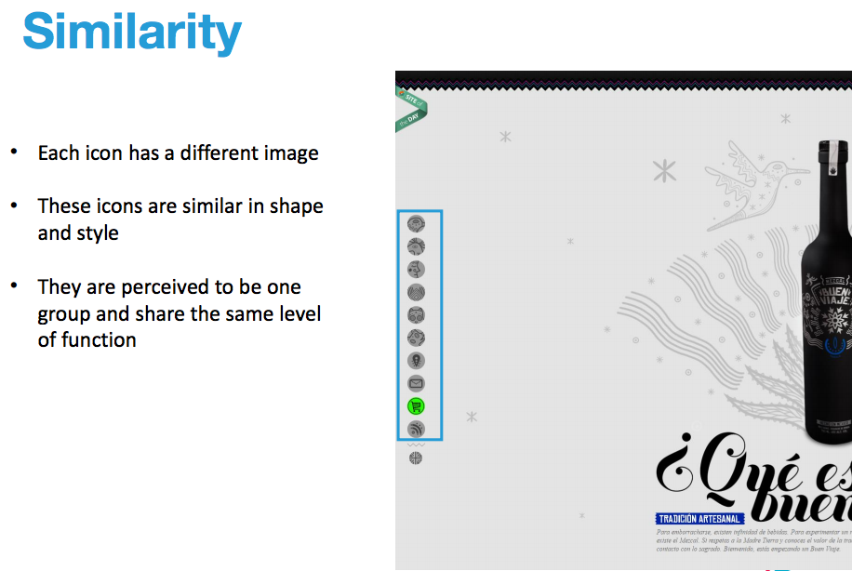

Slide 16
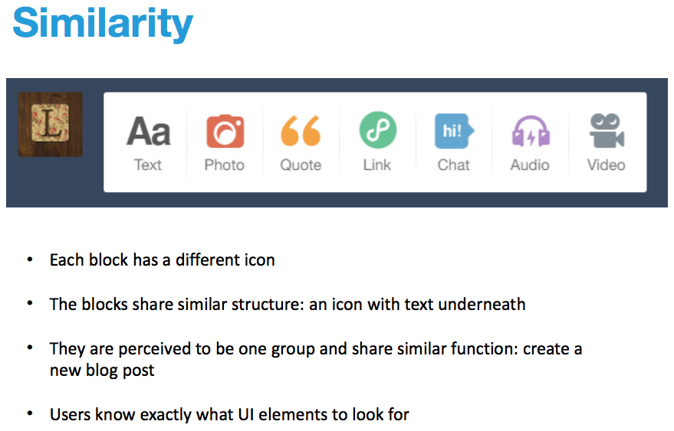

Slide 17
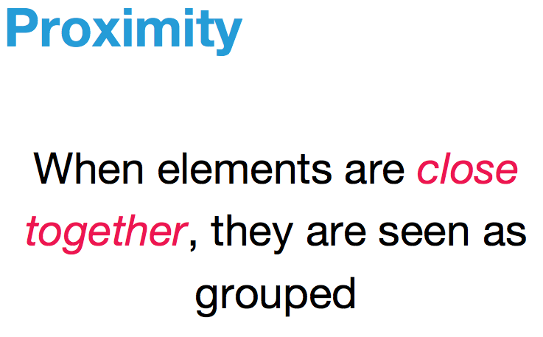

Slide 18
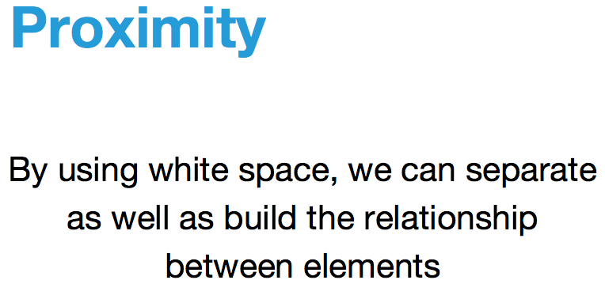

Slide 19
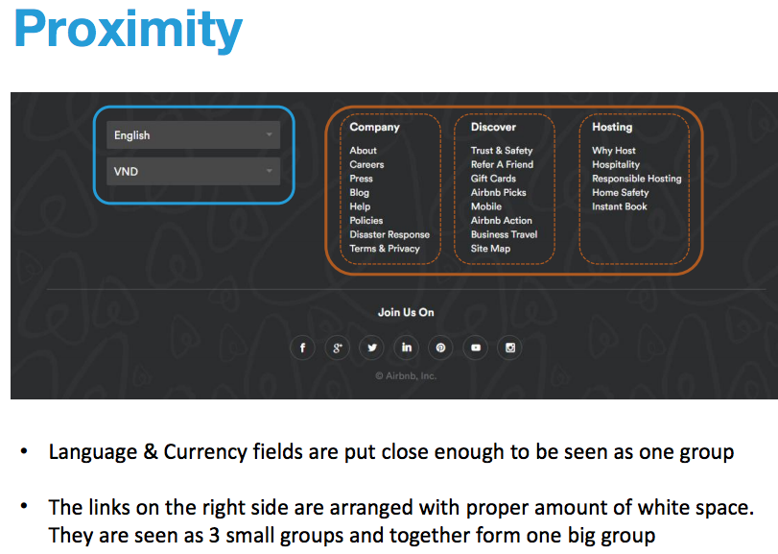

Slide 20
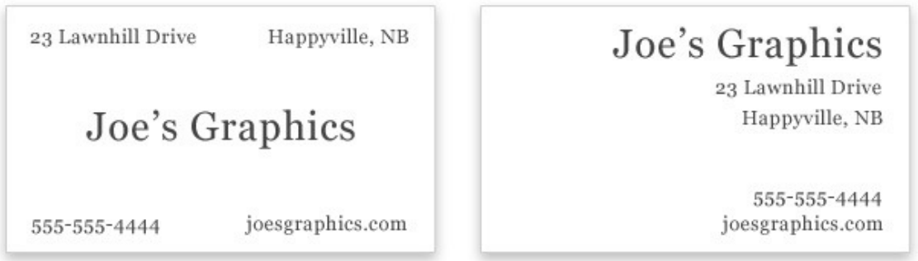
Proximity
White space, however, is just one part of implementing proximity.
A design can have a lot of white space, but if items are not grouped correctly, the white space will have little effect.
Two business cards
Source: https://www.webdesignerdepot.com/2010/01/the-principle-of-proximity-in-web-design/

Slide 21
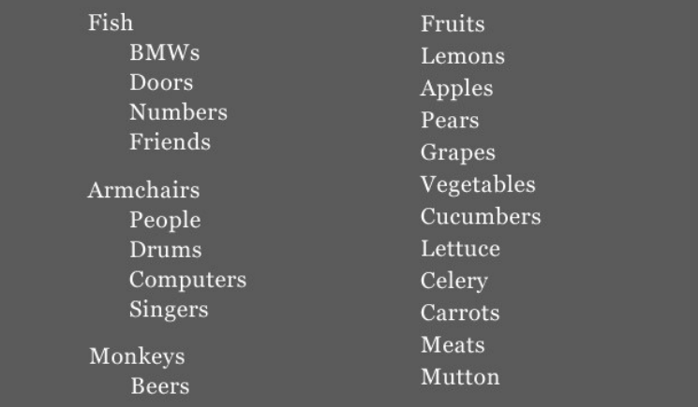
Proximity
Using white space effectively and grouping related elements are critical to giving your website a clear visual hierarchy.
Hierarchy is conveyed by the way in which elements are grouped and sub-grouped.
This hierarchy helps the user understand where they’ve been and where they want to go and, thus, helps to communicate the purpose of the website.
A list is a good example of an element that has the potential to communicate visual hierarchy.
The list on the left has a clear visual hierarchy, showing the relationships between items
(indented items are sub-categories of the primary items)
Source: https://www.webdesignerdepot.com/2010/01/the-principle-of-proximity-in-web-design/

Slide 22
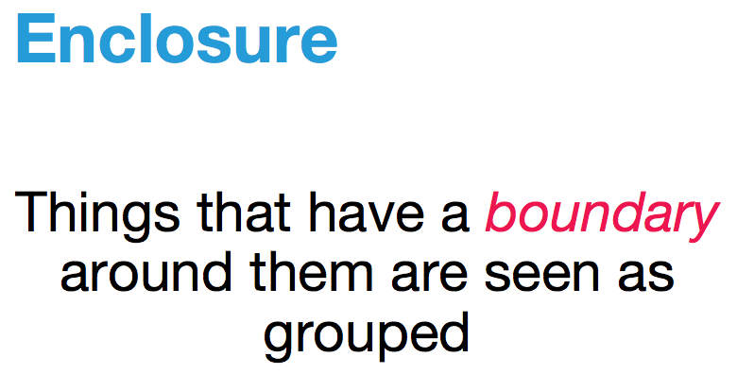

Slide 23
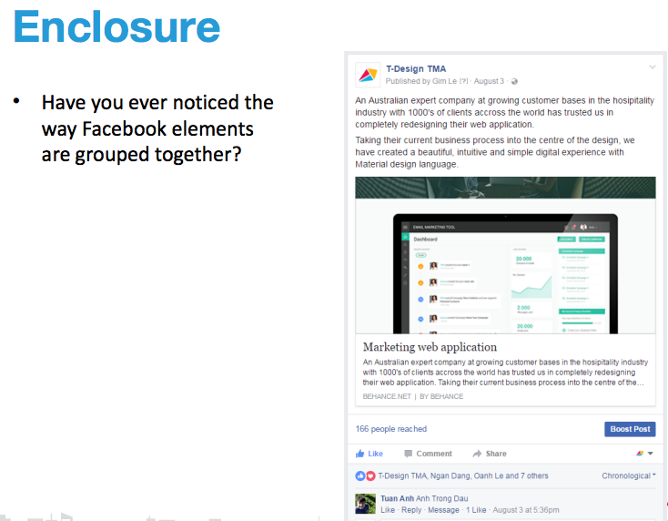

Slide 24
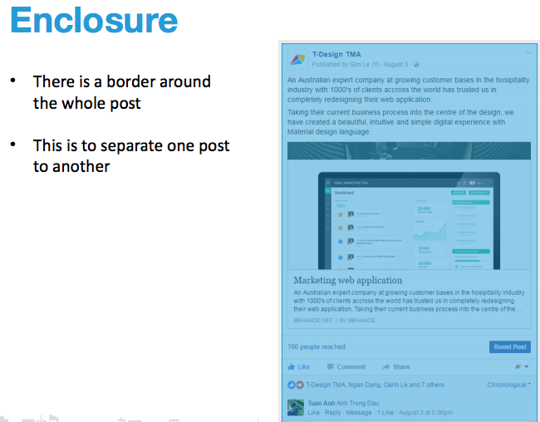

Slide 25
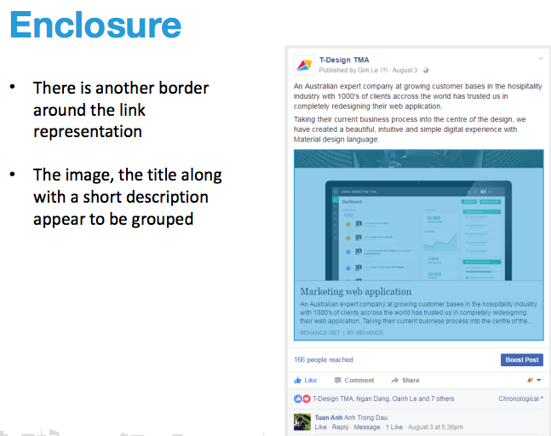

Slide 26
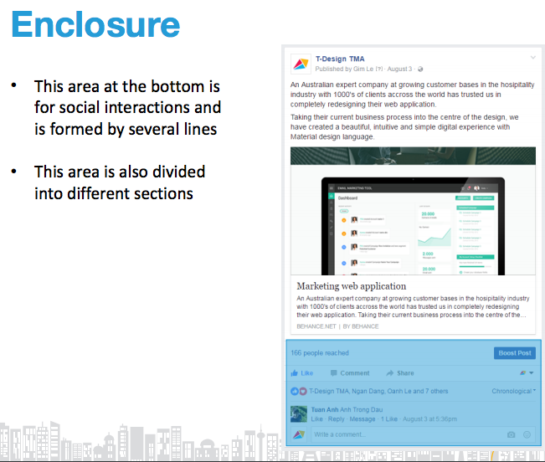

Slide 27
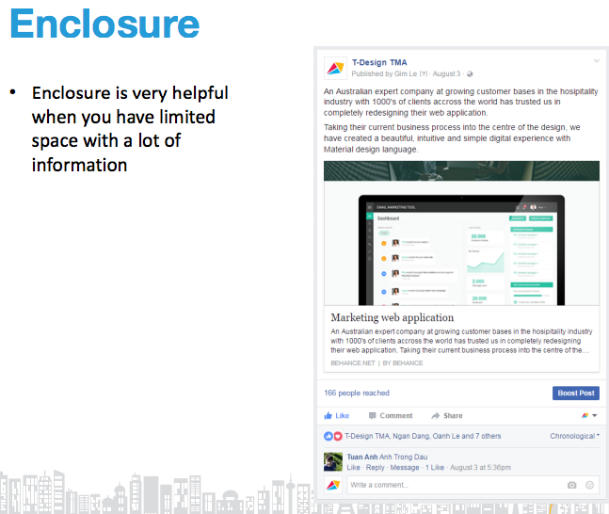

Slide 28
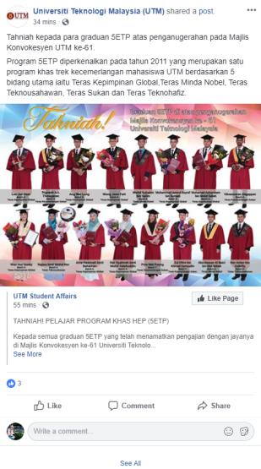
Enclosure
To separate the link of the
picture from the post
To separate one post
with another posts
To separate the comment
section for the related post
Source: https://www.facebook.com/univteknologimalaysia/

Slide 29
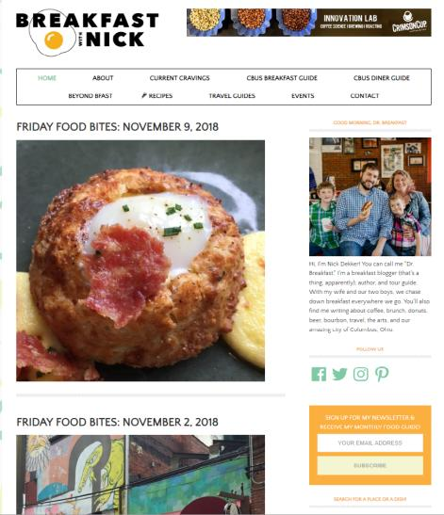
Enclosure
To separate the menu
options available in the blog
To separate one post
with another posts
To separate the link where
users can subscribe monthly
food guide by
Source: https://www.breakfastwithnick.com/

Slide 30
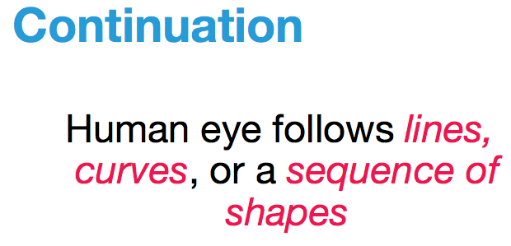

Slide 31
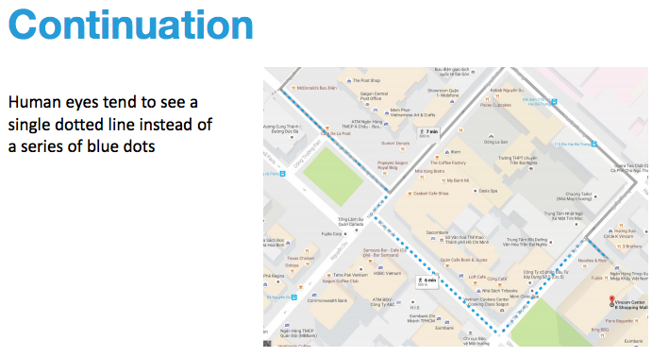

Slide 32
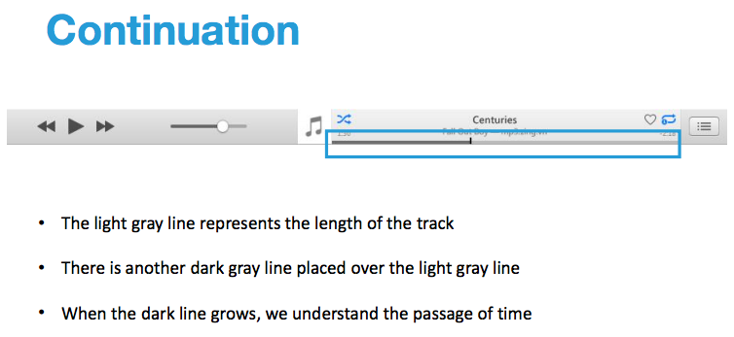

Slide 33


Continuation
The viewer’s eye will naturally follow a line or curve.
The smooth flowing crossbar of the “H” leads the eye directly to the maple leaf.
Principle of good continuity is when human perceive each of two or more objects as different, singular and uninterrupted object even when they intersect.
The alignment of the objects or forms plays a major role for this principle to take effect.
This principle is well used by educator to teach kids on how to write letters of the alphabet and draw images.
Sources: http://graphicdesign.spokanefalls.edu/tutorials/process/gestaltprinciples/gestaltprinc.htm
https://en.wikipedia.org/wiki/Principles_of_grouping

Slide 34
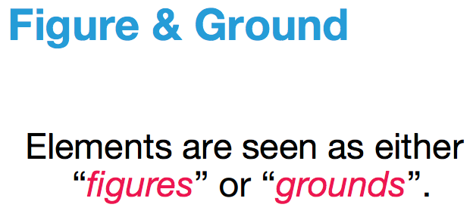

Slide 35
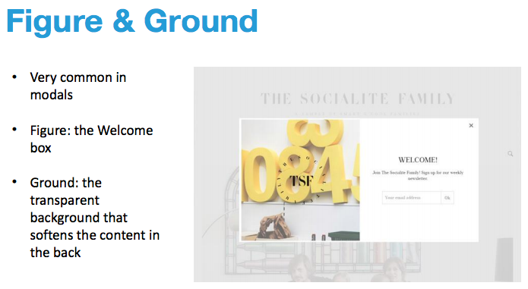

Slide 36
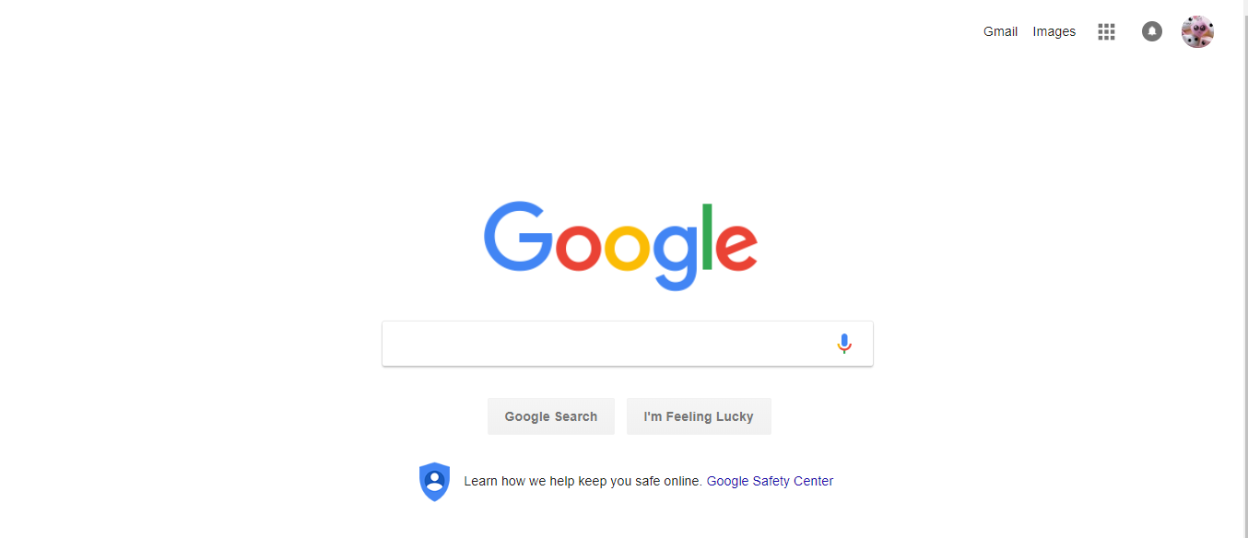

Figure & Ground
Example of figure (the Google text and search bar) and ground (the white background)
Example of figure (bird) and ground (the surrounding trees).
Sources:
https://wairimusensationndperception.weebly.com/figure-ground.html
https://www.google.com

Slide 37
Example of Gestalt Principles Applied to Web Design

Slide 38
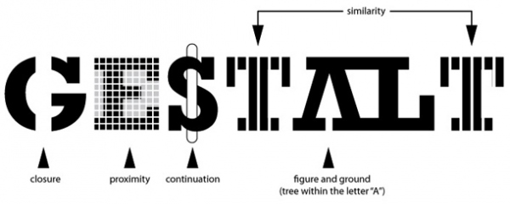
Example of Gestalt Principles
Applied to Web Design
Reference: Gayle Christopher, gaylechristopher.com

Slide 39
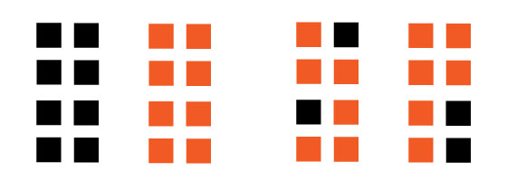
Proximity/Grouping
Things that are close together are perceived to be more related than things that
are spaced father apart.
One of the first principles to impact perception
Proximity overpowers similarity
Only uniform connectedness overpowers proximity
Proximity overpowers similarity in color/contrast

Slide 40
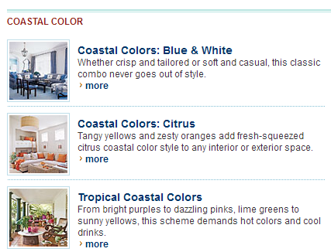
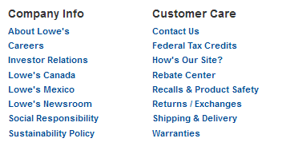

Proximity/Grouping

Slide 41
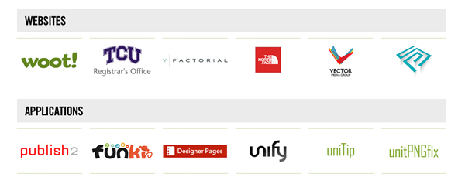
Good Continuation
Elements arranged on a line or curve are perceived to be more related than elements not on the line or curve.
All written language employs the principle of good continuation.
Breadcrumbs, words in a paragraph, graphs, and linear arrangement (vertical or horizontal) communicate relatedness.

Slide 42
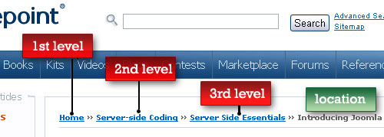
Good Continuation

Slide 43
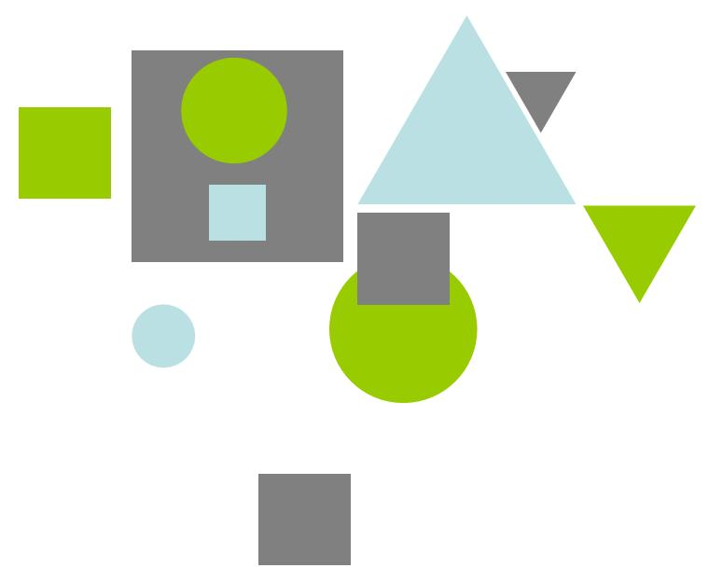

Similarity
Visual elements that are similar in shape, size, color and direction are perceived as part of a group.
Different modes of similarity are not created equal.
Color is the strongest way to suggest relationships.
Used in links, icons, page content to suggest similar behavior, relatedness, and reinforce content hierarchies to communicate context.
Consistency in styling and content dimension is important and implies structure.

Slide 44


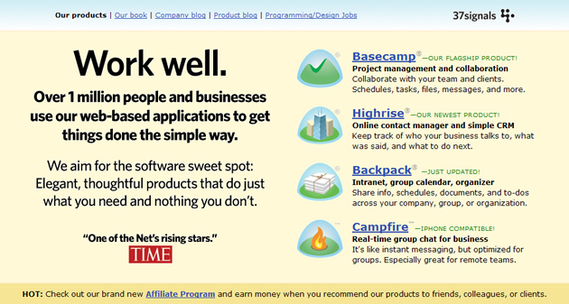
Similarity

Slide 45
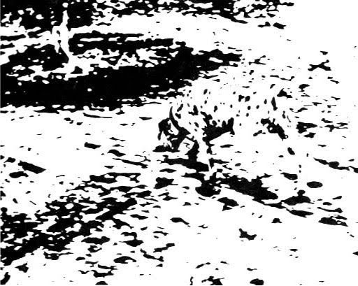


Figure-Ground
Elements are perceived as either figures (elements of focus) or background.
Human mind must rapidly decide which elements to focus on in a scene. This ability allows us to determine what we should pay attention to and what we can ignore even if it does provide context.
Use color, shading, highlights to cue the viewer in on what has focus and ground depth: buttons that look like press-able buttons, links that change on rollover, overlays that use shadow.

Slide 46
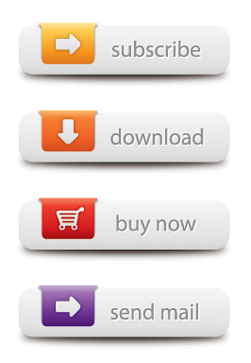
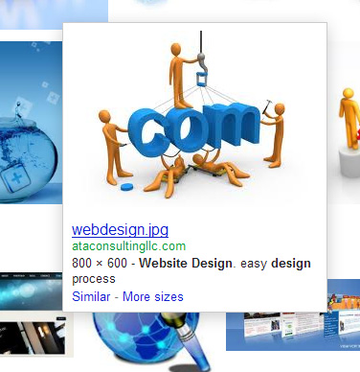
Figure-Ground

Slide 47
INDUSTRY
PRACTICES

Slide 48
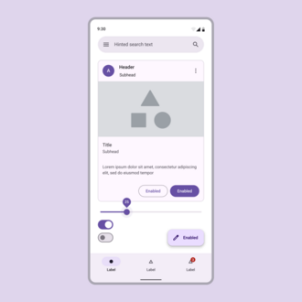
Google Material Design Principles
No. | Principle | Description
1 | Material is Metaphor | Uses tactile reality (shadows, surfaces, and edges) inspired by paper and ink to provide cues.
2 | Bold, Graphic, Intentional | Emphasizes deliberate color choices, edge-to-edge imagery, large-scale typography, and intentional white space.
3 | Motion Provides Meaning | Animations are meaningful and reinforce the user's actions, helping with orientation and continuity.
4 | Adaptive Across Devices | Designs are responsive, scalable, and work seamlessly on all screen sizes and devices.
5 | User Action Driven | Interfaces are focused on user input and promote direct manipulation with clear feedback.

Slide 49
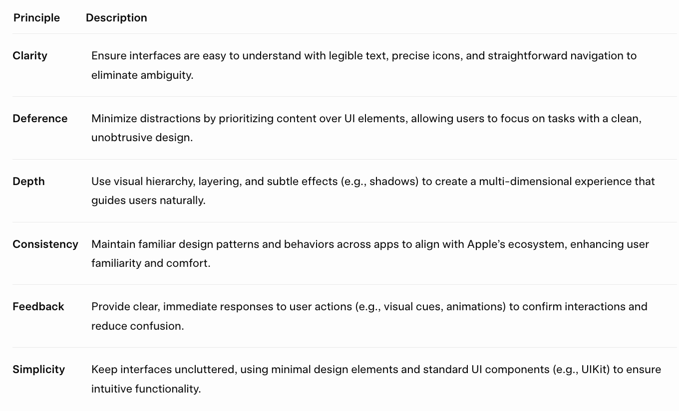
Apple Human Interface Guideline

